Slide 1
Python OOP
GUI
Pini shlomi

Slide 2
Graphical User Interface
Create user-friendly software applications with graphical elements such as buttons, menus, input fields, and more.
Make it easy for users to interact with software.
Intuitive interface than command-line interface.
Powerful tools for working with arrays and matrices of numerical data.
Tkinter is a popular GUI framework.
Why Tkinter :
Built-in to Python: included with Python installations.
Easy to use: Simple and intuitive interface.
Customizable: Wide range of widgets (e.g., buttons, menus, labels, textboxes, etc.)
Cross-platform compatibility: Available on multiple platforms(roots, macOS, and Linux).
Active community and documentation: A lot of documentation available .

Slide 3
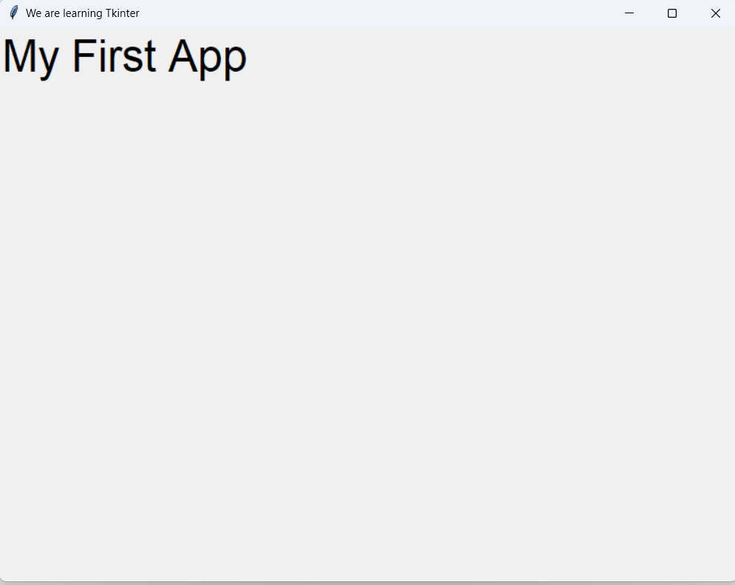
First App
import tkinter as tk
root = tk.Tk() root.title("We are learning Tkinter") root.geometry("800x600") lbl = tk.Label(root, text="My First App", font=("Arial", 36)) lbl.grid(column=0, row=0) root.mainloop() print(“App closed")

Slide 4
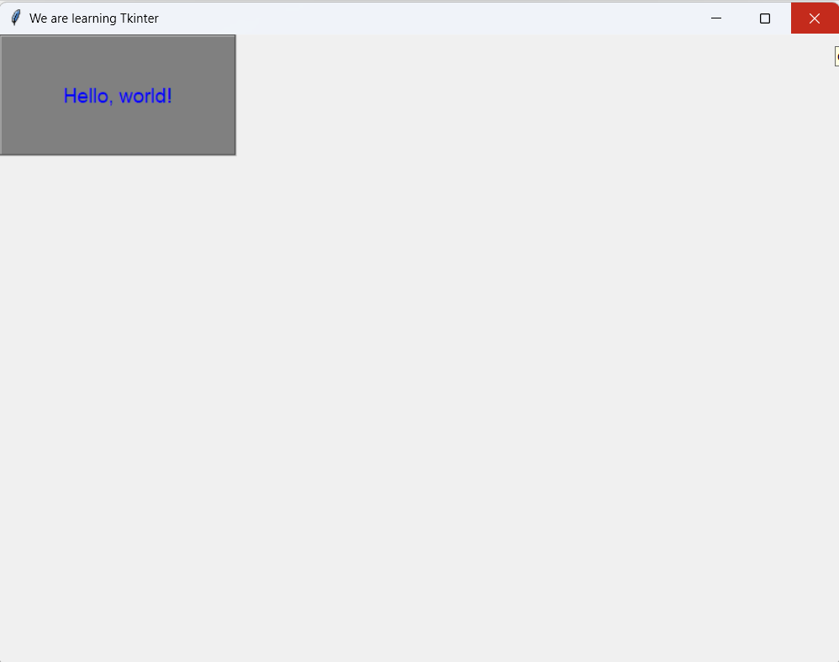
Label
widget for display text or an image on the screen
lbl = tk.Label( root, # parent widget text="Hello, world!", font=("Arial", 14), bg=“grey", # background color fg=“blue", # foreground color width=20, height=5, anchor="center", # position of the text in widget # values: n, ne, e, se, s, sw, w, nw, or center. justify="center", # alignment of the text in widget # values: left, center, or right. relief="groove" # how the edges of the widget are displayed # values: flat, raised, sunken, groove, or ridge. # image: image that should be displayed by the Label widget, # It can be set to an instance of the PhotoImage class. )

Slide 5
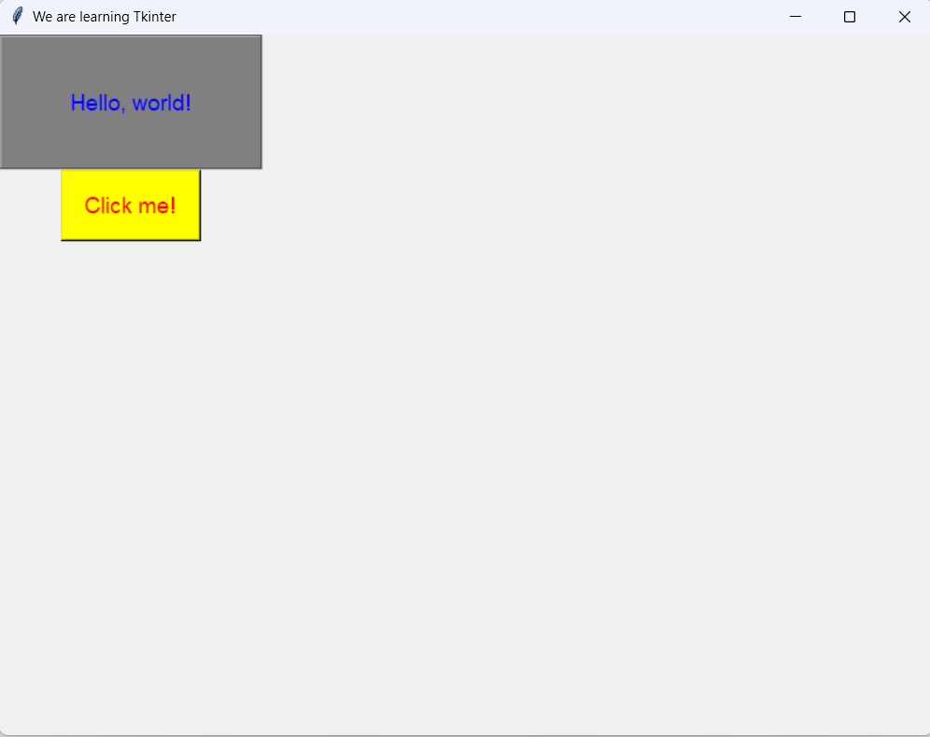
Button
widget for perform an action or trigger an event
btn = tk.Button( root, text="Click me!", font=("Arial", 14), bg="yellow", fg="red", width=10, height=2, command=button_clicked, # function that should be called # when the button is clicked. state="normal", # enable or disable,
# values: normal, active, or disabled relief="raised" )

Slide 6
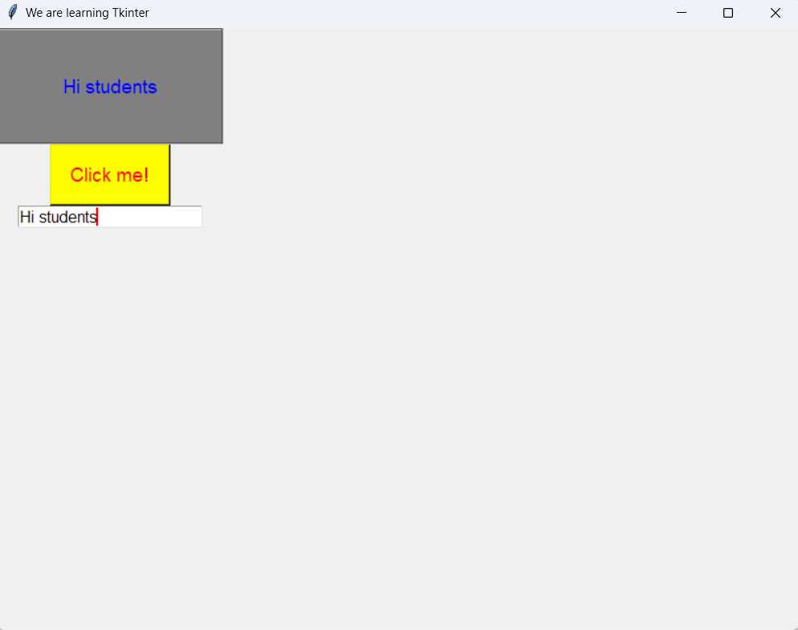
Entry
widget for create a single-line input
def on_entry_changed(lbl: tk.Label, text): lbl.config(text=text)
text_var = tk.StringVar() entry = tk.Entry( root, textvariable=text_var, # StringVar variable is used to store the text entered width=20, # show="*", # specify a character that should be displayed fg="black", bg="white", font=("Arial", 12), state="normal", # enable or disable, values: normal, readonly, or disabled insertbackground="red" # set the color of the insertion cursor ) entry.grid(column=0, row=2) text_var.trace("w", lambda name, index, mode, text_var=text_var: on_entry_changed(lbl, text_var.get()))

Slide 7
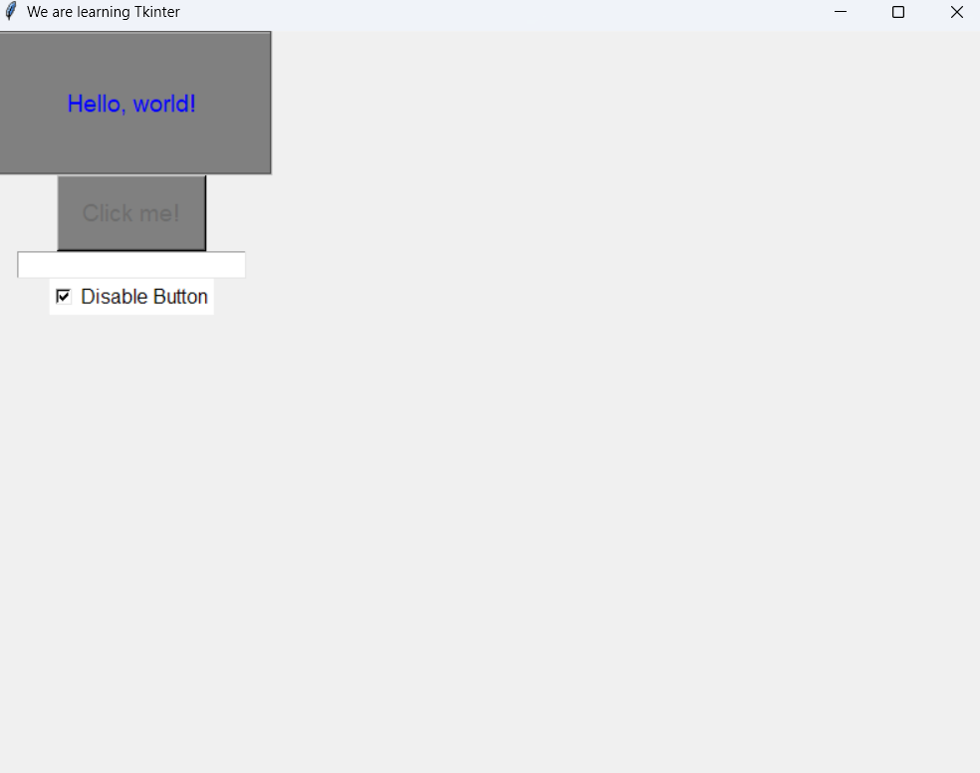
Checkbutton
widget for check button that can be turned on or off
def on_checkbutton_changed(checkbutton_var: tk.BooleanVar, btn: tk.Button): if checkbutton_var.get(): btn.config(state='disabled', bg="grey", ) else: btn.config(state='normal', bg="yellow", )
checkbutton_var = tk.BooleanVar() checkbutton = tk.Checkbutton( root, text="Disable Button", variable=checkbutton_var, onvalue=True, offvalue=False, command=lambda ch_bt_var=checkbutton_var, b=btn: on_checkbutton_changed(ch_bt_var, b), fg="black", bg="white", font=("Arial", 12), activebackground="gray" ) checkbutton.grid(column=0, row=3)

Slide 8
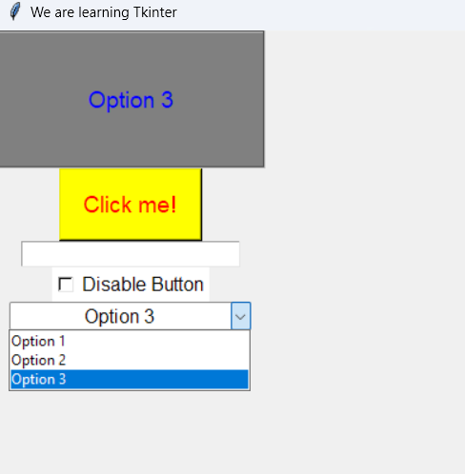
Combobox
widget for a drop-down menu with a list of options
def on_combobox_changed(event, text, l1): l1.config(text=text)
combobox_var = tk.StringVar() values = ['Option 1', 'Option 2', 'Option 3'] combobox = ttk.Combobox( root, values=values, textvariable=combobox_var, state='readonly', # enabled or disabled, values normal, readonly, and disabled width=20, font=('Arial', 12), foreground='black', background='white', justify='center' ) combobox.bind('<<ComboboxSelected>>', lambda event, cb_var=combobox_var, l1=lbl: on_combobox_changed(event, cb_var.get(), lbl)) combobox.grid(column=0, row=4)

Slide 9
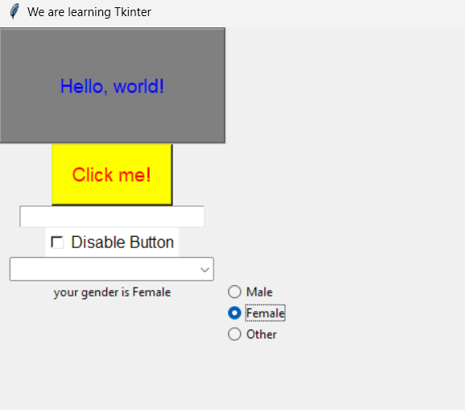
Radiobutton
widget of a group of radio buttons where only one option can be selected at a time
def on_radiobutton_selected(text, lbl): lbl.config(text=f'your gender is {text}’)
gender_lbl = tk.Label(root, text='What is your gender?') gender_lbl.grid(column=0, row=5) gender_var = tk.StringVar() gender_values = ['Male','Female','Other'] row = 5 for gender in gender_values: r = ttk.Radiobutton( root, text=gender, value=gender, variable=gender_var, command=lambda t=gender, lbl=gender_lbl: on_radiobutton_selected(t, lbl), ) r.grid(sticky='w', column=1, row=row) row += 1

Slide 10
Messagebox
widget for display message
from tkinter import messagebox
root = tk.Tk() root.title('We are learning Tkinter') root.geometry('800x600') info_button = tk.Button(root, text="Show Info Message", width=20, height=2, command=show_info_message) info_button.grid(column=0, row=1) warning_button = tk.Button(root, text="Show Warning Message", width=20, height=2, command=show_warning_message) warning_button.grid(column=0, row=2) error_button = tk.Button(root, text="Show Error Message", width=20, height=2, command=show_error_message) error_button.grid(column=0, row=3) question_button = tk.Button(root, text="Ask Question", width=20, height=2, command=ask_question) question_button.grid(column=0, row=4) ok_cancel_button = tk.Button(root, text="Ask OK/Cancel", width=20, height=2, command=ask_ok_cancel) ok_cancel_button.grid(column=0, row=5) yes_no_button = tk.Button(root, text="Ask Yes/No", width=20, height=2, command=ask_yes_no) yes_no_button.grid(column=0, row=6) root.mainloop()

Slide 11
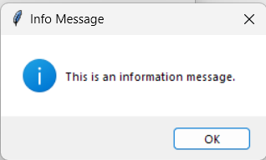
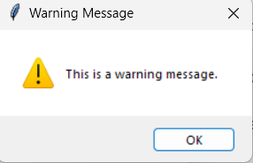
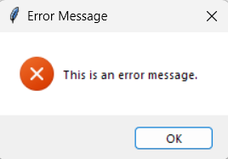
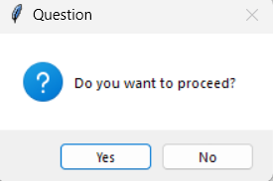
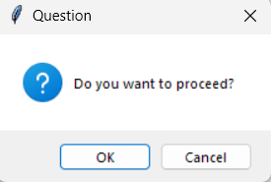
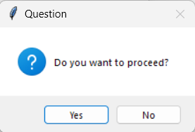
Messagebox
def show_info_message(): messagebox.showinfo("Info Message", "This is an information message.") def show_warning_message(): messagebox.showwarning("Warning Message", "This is a warning message.") def show_error_message(): messagebox.showerror("Error Message", "This is an error message.")
def ask_question(): # return ‘yes’ or ‘no’ response = messagebox.askquestion("Question", "Do you want to proceed?") def ask_ok_cancel ():# return True or False response = messagebox.askokcancel("Question", "Do you want to proceed?") def ask_yes_no():# return True or False
response = messagebox.askyesno("Question", "Do you want to proceed?")

Slide 12
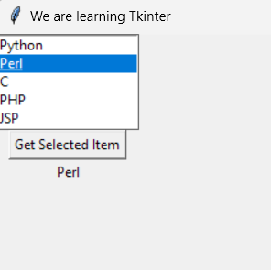
Listbox
widget for display a list of items
def get_selected_item(listbox, label): index = listbox.curselection() if index: item = listbox.get(index) label.config(text=item)
listbox = tk.Listbox(root, height=5) listbox.grid(column=0, row=0) program_lang = ['Python', 'Perl', 'C', 'PHP', 'JSP', 'Ruby'] for i, lang in enumerate(program_lang): listbox.insert(i, lang)
label = tk.Label(root, text='') label.grid(column=0, row=2) button = tk.Button( root, text='Get Selected Item', command=lambda lb=listbox, lbl=label: get_selected_item(lb, lbl)) button.grid(column=0, row=1)

Slide 13
Charts
Show/hide chart trigger by button
import tkinter as tk from tkinter import W, NSEW import matplotlib.pyplot as plt import numpy as np from matplotlib.backends.backend_tkagg import FigureCanvasTkAgg chart = None button = None
def create_button(root): global button button = tk.Button( root, text='Show Sinus Wave', command=lambda : create_chart(root) ) button.grid(column=0, row=0, sticky=W)
def create_chart(root): global chart global button if chart and chart.winfo_exists(): chart.destroy() button.config(text='Show Sinus Wave') else: x = np.linspace(0, 2 * np.pi, 100) sin_x = np.sin(x) fig = plt.Figure(figsize=(5, 3), dpi=100) ax = fig.add_subplot() ax.plot(x, sin_x) ax.set_title('Sinus Wave') canvas = FigureCanvasTkAgg(fig, root) chart = canvas.get_tk_widget() chart.grid(row=1, column=0, sticky=NSEW, columnspan=6) button.config(text='Hide Sinus Wave')

Slide 14
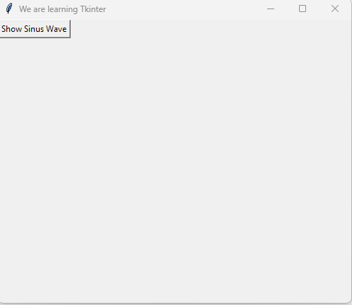
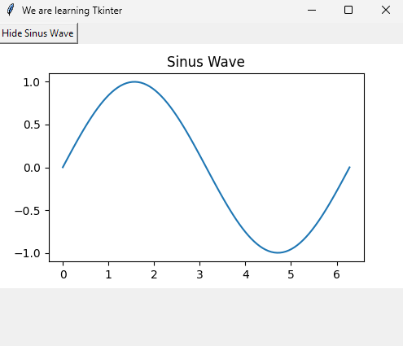
Charts
Show/hide chart trigger by button
def main(): root = tk.Tk() root.title('We are learning Tkinter') root.geometry('500x400') create_button(root) root.mainloop() if __name__ == '__main__': main()

